Slide 1
?
A
B
C
Fixed wheel
Turnable wheel
Heading

Slide 2
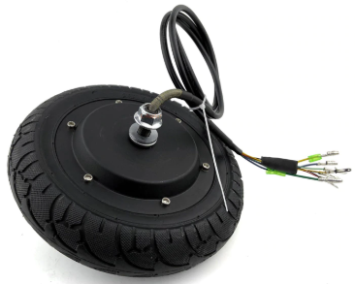
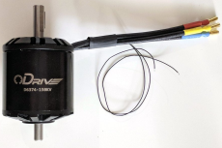
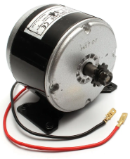
?
A
B
C
Brush less
Hub motor
Brush less
normal dual shaft
Brushed
motor

